Slide 1
Naive Bayesian text classification
from Rune A. Laursen, Ole Gunvaldsen, Peshang Alo

Slide 2
Data Parsing
sklearn (Remove) - “header”, “footer”, “quotes”
Enchant - english dictionary
Stopwords - non-important words
Lowercase - When splitting the text, convert all letters to lowercase letters.
PorterStemmer - reduce word to the stem
Vocabulary - creating a vocabulary storing all the words from all the texts
Dictionary - sorting all the words under different keys
Notes:
When using Native Bayes to make a classifier, some of the most important parts to get high accuracy is how the data used is parsed,
we started looking at the newsgroups dataset and found out we could use function parameter “remove” where we can choose to remove “headers”, “footers” and “quotes”, and also choose the subsets “train” and “test” to make it easier to use the data.
enchant is a dictionary that can be used to ensure that the word in question actually is an english word.
“Stopwords” are meaningless words that is not important for the content of a text
lowercase is used on all words to further decrease the size of the vocabulary.
PorterStemmer is used to find the stem of the word, this will make the vocabulary a lot smaller only keeping the stem of the word.
the vocabulary is created after all of the above is used on the text and have removed less essential words.
the dictionary is then created by using the words from the all texts which is mapped to the index in the vocabulary, and the 20 keys used are the categories.

Slide 3
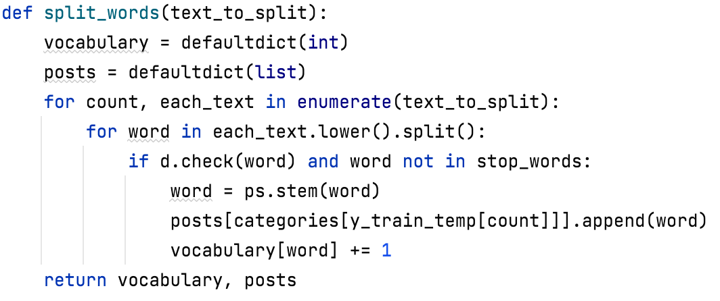
Split words
Notes:
We created a function that iterates through the text which splits it and returns both a vocabulary and a dictionary

Slide 4
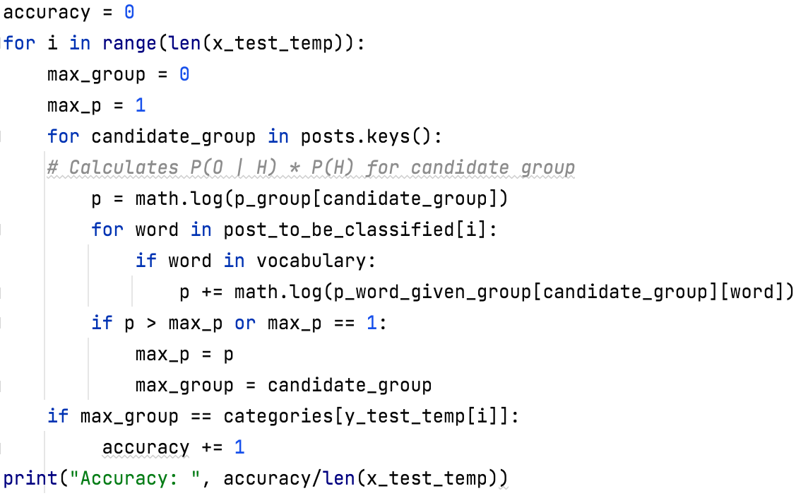
Calculating the probability
Notes:
Starts with calculating the probability of each group (p_group) which is the number of texts in each category divided by the total number of texts.
Loop through each word in the text and check if it found in the vocabulary, if so then sum the logarithm of the word probability in specific category.
The category with highest max_p will then be the predicted category.
in this example, we use the natural logarithm instead of multiplication, this is to avoid that the computer changes very small numbers to zero.

Slide 5


Results
 | Removed Header & Footer | Using English dictionary | Stemmer | Lemmetizer | Lowercase | Vocabulary Size | Accuracy
Try 1 |  |  |  |  |  | 15 441 | 52.6%
Try 2 |  |  |  |  |  | 15 441 | 58.0%
Try 3 |  |  |  |  |  | 15 441 | 65.0%
Try 4 |  |  |  |  |  | 235 551 | 65.5%
Try 5 |  |  |  |  |  | 235 551 | 63.0%
Try 6 |  |  |  |  |  | 275 704 | 78.8%
Try 7 |  |  |  |  |  | 248 227 | 79.8%
Notes:
In all the results here, we used the entire training set to create the vocabulary, and the whole test set to test and measure the accuracy.
To increase accuracy, we tried to change up the word processing by keeping header and footer, this gave a worse result
We then tried to instead remove the english dictionary which gave better results.
this shows that we could keep on changing the parsing, and what words will be used to maybe increase the accuracy even further.
when lemetizer was added instead of stemmer, even higher accuracy was achieved

Slide 6
Code
https://github.com/PeshangALO/Learning_Systems/blob/main/Assignment_4/main.py

